Slide 1
CFA Exam Strategies & Reminders

Slide 2
Test-Taking Tips & Tactics
Following is a set of test-taking tips and tactics developed by our team of subject matters, each one with at least a decade of experience in helping candidates prepare for their CFA Exams:
Seven most serious mistakes candidates make in taking the CFA Exams
Wiley’s Tips & Tactics
What to Do Next?

Slide 3
Seven most serious mistakes candidates make in taking the CFA Exams
To begin, let’s take a look at Wiley’s solutions, tips, and examples in response to what the CFA Institute states are the three most serious mistakes candidates make in taking the CFA Exams:
Poor preparation
Anxiety, Panic, and an inability to handle pressure
Poor time management
Reading questions too quickly
Over-thinking the questions
Giving answers not found in the CFA Program curriculum
Failure to follow instructions
4 thru 7 can be symptoms of the first 3 causes.

Slide 4
Seven most serious mistakes candidates make in taking the CFA Exams
1. POOR PREPARATION
CFA Institute has stated that the single most important reason candidates fail the exam is poor preparation: They failed to study the assigned readings sufficiently to fully understand the CFA Program curriculum and Learning Outcome Statements.
SOLUTION:
At this stage: Intensive Revision (“Bootcamp”)
Going forward: Remember the 300 hour rule; start early

Slide 5
Seven most serious mistakes candidates make in taking the CFA Exams
2. ANXIETY, PANIC, AND AN INABILITY TO HANDLE PRESSURE
Even well-prepared candidates sometimes fail the exam.
Queue the second most important reason candidates fail: an inability to handle the pressure well. A commonly cited reason for failure is that a naturally high level of anxiety turns to panic when a series of difficult questions appears. Panic can cause the mind to go blank, leading to unwarranted mistakes, even physical incapacitation.
SOLUTION: Develop or improve your coping mechanisms; pro/life coach
TIP: If your anxiety level starts rising too high, take a deep breath and remind yourself that all you need is a minimally passing score. Just do what you’ve trained to do and forget about outcomes.
EXAMPLE: Reading questions too quickly can lead to misinterpretation, which can result in wrong answers. Reading too fast can be a by-product of anxiety or poor time management (falling behind and speeding to catch up).

Slide 6
Seven most serious mistakes candidates make in taking the CFA Exams
3. POOR TIME MANAGEMENT
Queue the third most important reason candidates fail: unsuccessful candidates often leave too many questions unanswered.
SOLUTION: mocks/CFAI PQs under “candidate resources” → Do lots of practice questions to hone your skills in this regard.
EXAMPLE: If your solution to a question is highly complex and cumbersome, you could be off on a tangent. Keep in mind that the exam questions are designed to be answered in minutes. Extremely lengthy and complex solutions may not be the right ones. The vast majority of the questions require only straightforward, primary responses rather than secondary or tertiary effects. Don’t look for complexity where none exists. If you do, you could cause yourself to run out of time.

Slide 7
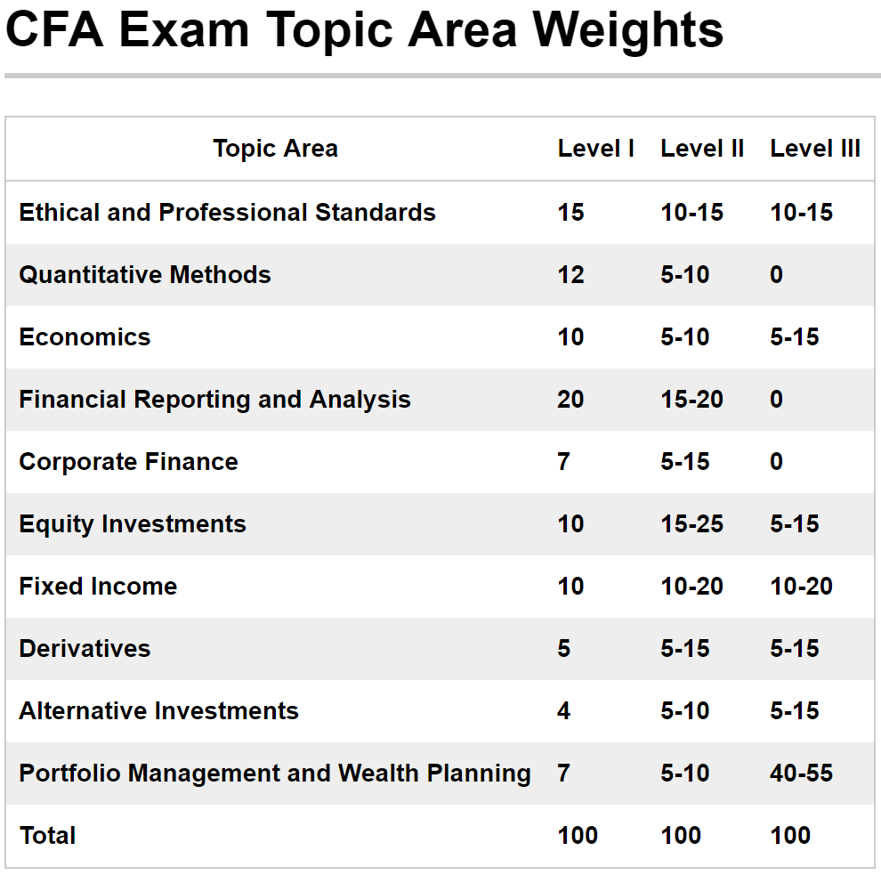
Let the Weightage Guide You
These are the exam topic weights. Note the most important topics. FRA, Ethics, QM
There are 240 multiple-choice questions on the Level 1 CFA Exam. So pace and stamina is important!
Note that no one has ever failed the CFA exam with a score below 70%…so that's the target. That means you can easily miss 72 questions and still pass!

Slide 8
Circle’n Annotate
Example:
An analyst is analyzing a stock that is currently trading at $31 per share. She thinks the stock’s dividends per share should be $2.00 next year, after which they should grow at 25% per year for each of the next two years. Then, beginning in year 4, the growth rate is expected to decline and stabilize at 8% per year.

Slide 9
Circle’n Annotate
D₁
P₀
Example:
An analyst is analyzing a stock that is currently trading at $31 per share. She thinks the stock’s dividends per share should be $2.00 next year, after which they should grow at 25% per year for each of the next two years. Then, beginning in year 4, the growth rate is expected to decline and stabilize at 8% per year.
g_{HI}
g_{LO}

Slide 10
How the Level II Exam Differs from Level I
Vignettes can be quite involved with the data you need either:
buried in the text; or
mixed in a table with irrelevant data.
As you read each vignette, you should circle and/or underline the relevant data that you're going to need.
Making annotations in the margins of the exam booklet also helps.
The point is to get the relevant data out to where you can get at it without re-reading the vignette three times!!! ☹.
Level II is 100% multiple-choice in item set format.
An Item set is a long case or vignette followed by six multiple-choice questions relating to the case.
Because it takes longer to read the item sets, there are only 120 questions on the Level II exam.
Level II emphasizes asset valuation and application of the tools learned at Level I.

Slide 11
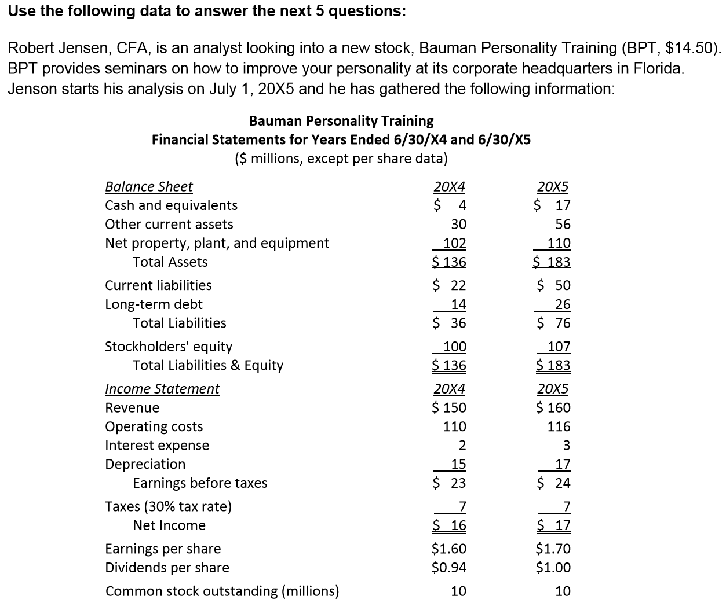
Circle’n Annotate
Chris Ansell, CFA, is an analyst looking into a new stock, Degraaf Bodybuilding Institute (DBI, $14,50). DBI provides seminars on how to improve your physique at its corporate headquarters in Baldavia. Ansell starts his analysis on July 1, 20X5 and he has gathered the following information:
Degraaf Bodybuilding Institute
Financial Statements for Years Ended 6/30/X4 and 6/30/X5
($ millions, except per share data)

Slide 12
Circle’n Annotate
DBI's free cash flow to the firm (FCFF) for the year ending June 30, 20X5 is closest to:
$(3.9) million.
$9.1 million.
$13.1 million.

Slide 13
Circle’n Annotate
Choice "c" is correct.
The FCFF is calculated as follows:

Slide 14
Circle’n Annotate
Chris Ansell, CFA, is an analyst looking into a new stock, Degraaf Bodybuilding Institute (DBI, $14,50). DBI provides seminars on how to improve your physique at its corporate headquarters in Baldavia. Ansell starts his analysis on July 1, 20X5 and he has gathered the following information:
Degraaf Bodybuilding Institute
Financial Statements for Years Ended 6/30/X4 and 6/30/X5
($ millions, except per share data)
∆Net PP&E + D = FC Inv
(110 – 102) + 17 = 25
∆OA - ∆OL = WC Inv
= (56-30) – (50-22) = -2

Slide 15
Let the Weightage Guide You
There are 120 multiple-choice questions in item set format on the Level 2 CFA Exam, but they're longer. So pace and stamina is still very important! These are the exam topic weights. Note the most important topics. FRA includes Corporate Finance; Asset Valuation comprises Equity, Debt, Derivatives, and Alternative Investments.
Note that no one has ever failed the CFA exam with a score below 70%…so that's the target. That means you can easily miss 72 questions and still pass!

Slide 16
How the Level III Exam Differs from Level II
Time management is key --
The essay questions are the biggest difference between LII and LIII.
The item sets (afternoon) are the same as you saw at LII.
There are 360 minutes allotted to complete the entire exam (the same as you saw at LI and LII), 3 hours in the morning and 3 hours in the afternoon.
Time management is most critical for the Essay section of the exam because, unlike multiple-choice, if you run out of time, you can't just randomly guess and have any chance at winning some points by luck.
See sample exams on CFA Institute's website under "candidate resources."

Slide 17
How the Level III Exam Differs from Level II
Note time allotted to each question --
Note especially the time allotted to each question; i.e., 12 marks = 12 minutes
This is also the point value and will give you some idea of how much you are expected to write in your answer.
Use bullet-point format --
Your answer should be in outline or bullet-point format.
There's no need to write in complete sentences (grammar, style, form doesn't count for or against you), but be careful that you get your point across clearly (make it easy for the grader).
Think first, then write --
Answer in the space/template provided.
Before you begin writing, think for a minute so you don't wind up scratching out large sections (i.e., don't confuse the grader).

Slide 18
Types of Essay Questions
There are 10-15 essay questions (once again, all on the morning paper) and some questions contain a mix of the following two question and answer types:
Short answer → One type asks you to write your answers on the lined page(s) following the question.
Fill in the table → The second type asks you to provide your answers in a template following the question.
Each question may have as few as one part or as many as 7-8 parts, so be sure to read and understand the entire question; so, once again…
Note time alotted to each question;
Think first, then write; and
Use bullet-point format

Slide 19
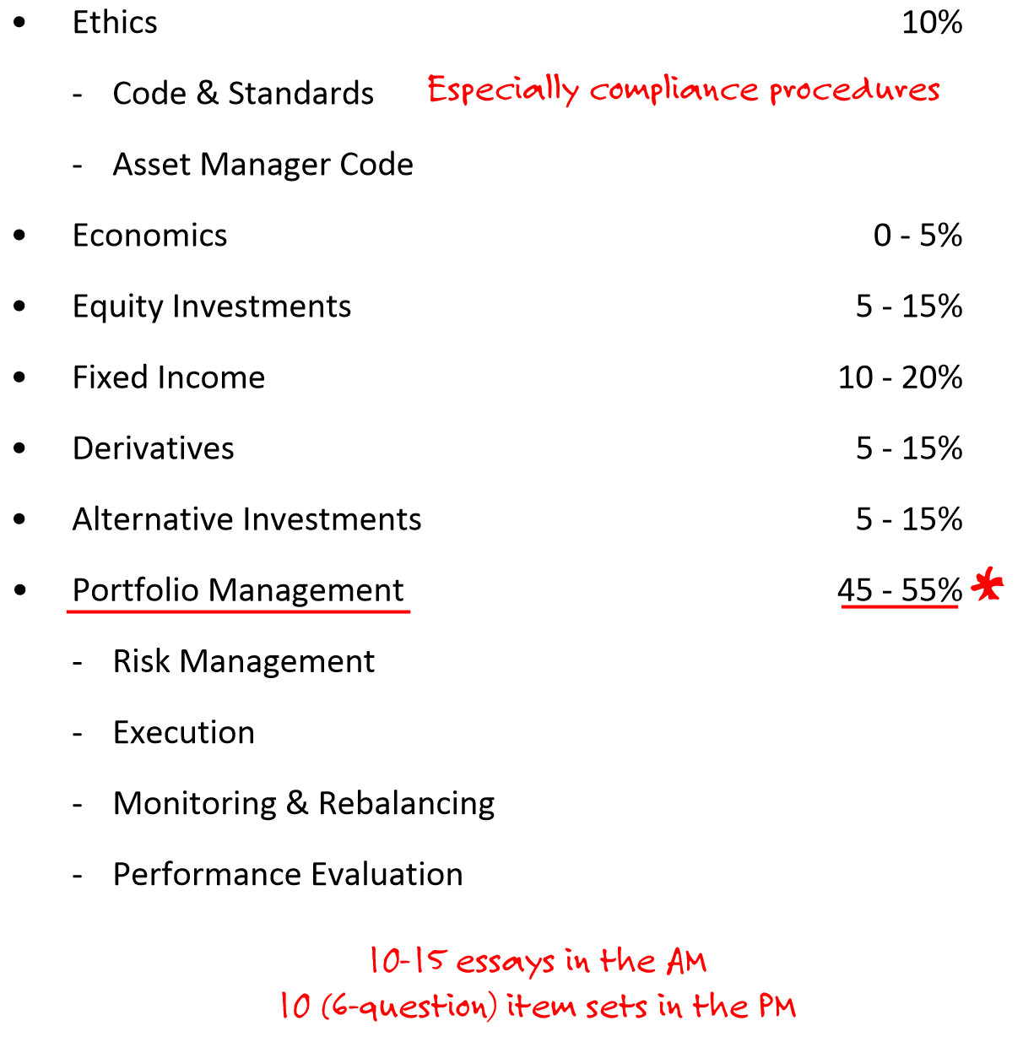
Level III CFA Exam Topic Weights
10 – 15%
In Ethics, the Recommended Compliance Procedures are more heavily emphasized at LIII than at LI and LII.
Note the most important topic: Portfolio Management.
5 – 15%
40 – 55%

Slide 20
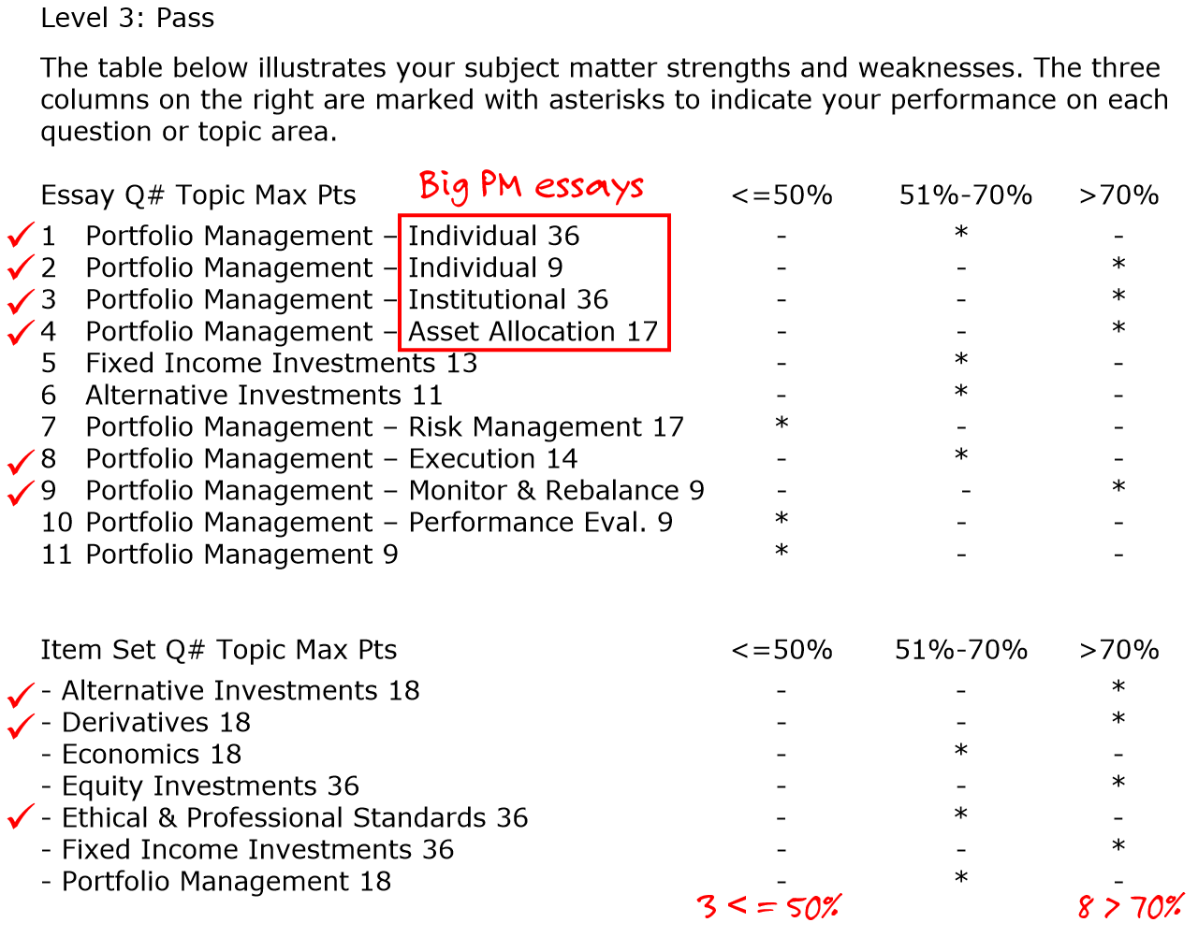
This is a typical grade report from CFA Institute for the 2008 exam
Weightage –
Note the topics and the number of points allotted for each essay, particularly the two big PM essay questions
Individual, and
Institutional.
Item sets –
Also note that certain topics are usually tested only in item sets
Ethics,
Derivatives,
Alternative Investments,
while others can be tested in either or both sections
Economics,
Equity,
Fixed Income, and
Portfolio Management.

Slide 21
Your Target → A Passing Score, not a Perfect Score!
According to CFA Institute, no one has ever failed the CFA exam with a score of 70% or better…so that's the target.
That means you can miss at least 108/360 points and still pass! So take heart that you can botch a few questions and still pass, but you must offset those with higher scores in others. You're shooting for a passing score, not a perfect score!
Your strategy should be to maximize your point total (so don’t be distracted by rumours such as minimum scores in Ethics).
The report on the previous slide might help you prioritize. But, realize that the exam changes from year to year (although it is fairly representative of the last few exam years [pre-2008]).

Slide 22
LIII Tips from Lisa Chen (of CFA Institute)
Show all your calculations
State your assumptions
Pick a team
Don't contradict yourself... for if you do, you could get a zero overall for that Q.
Don't show off your knowledge. It could confuse your grader.
Instead, focus on the operative word: describe vs. identify; e.g., identify 5 hedge funds vs. describe (attributes like pros and cons).
Not grading for language, style, or spelling - they just need to be able to understand what you're writing.
So the key is to write legibly
And write in pen (cuz pencils can smudge)
If they ask for 2 reasons for blah blah... only give 2. They will cross out anything they see below the first 2.

Slide 23
Wiley’s Tips & Tactics
Wiley’s Tips & Tactics can be broken down in terms of time:
May;
June;
“D-Day – 2”;
“D-Day – 1; and finishing up with,
The exam day itself
Like a powerlifter, marathon runner, etc., you have trained for some time for this one performance. On the scheduled day of the event, know that one misstep can mean that all your hard work will be for nothing. Yet, if you dwell too much on that possibility, the likelihood of faltering actually increases. Here are some tips in that regard:

Slide 24
Wiley’s Tips & Tactics
What you Should Be Doing in May
CFAI PQs (the ones on their website – under the “candidate resources” tab). These are not to be mistaken for their EOC questions.
Old CFAI mocks (starting from newest to oldest).
2018 mock exams from recognized exam prep providers (“the other guys”/Wiley)
Wiley 2-Day Intensive Review
Wiley 11th Hour Review

Slide 25
Wiley’s Tips & Tactics
What you Should Be Doing in June
As a general comment, resolve to simply do what you’ve practiced and let the chips fall where they may.
Focus on mock exams. For the most part, put down your books, notes, videos, etc. and write/review mock exams.
The best practice is to spend 1 ½ times the amount of time reviewing an exam as writing it.
More specifically, write/review 2018 CFAI mock(s) and – to the extent you can - re-review other mocks/old CFAI exams written thus far.
Visit the exam site one or two weeks before the exam date to help relieve anxiety. You see how long it takes to get to the site, where you can park, and the exact location of the exam room. If you can, go into the exam room and get comfortable with the surroundings.

Slide 26
Wiley’s Tips & Tactics
“D-Day – 2”
Level III
AMC
GIPS
Level II
IFRS vs. U.S. GAAP
ROS
Value/Price formulas from derivatives, IR, bootstrapping, cross rates
Level I
IFRS vs. U.S. GAAP
GIPS
Pure play, convexity, σ of a 2-asset portfolio, fully-diluted EPS

Slide 27
Wiley’s Tips & Tactics
“D-Day – 1” – Take a Netflix vacay
The pressure to succeed is positive when it provides an incentive to study and prepare well. It can become a negative force if it leads to anxiety or panic and adversely affects your test-taking performance on exam day.
Don’t cram the night before the test. Chill out and work off any pent-up performance anxiety. Reserve the day immediately before the exam for relaxation and laying out all the items you’ll need to take to the exam with you. Here are a few important reminders for the day before the test:
Gather up the pencils you will take to the exam. Sharpen them, but not to the point where they will break. Wear them in a little bit.
Test your TI BA II Plus or HP 12C (e.g., ensure it is END mode)
Organize your calculator(s), spare battery, pencils, exam admittance card, and valid international passport in a conspicuous place.
Set your alarm clock for early enough in the morning (AM not PM).

Slide 28
Wiley’s Tips & Tactics
TAKING THE EXAM: EXAM-DAY STRATEGIES
Wiley’s strategies for the big day itself are broken down into the following categories:
Wise time management
No need to show your work
No points are subtracted for selecting incorrect answer choices
C+ is your target: passing score, not perfect score
Leave home early
Follow the rules

Slide 29
Wiley’s Tips & Tactics – TAKING THE EXAM: EXAM-DAY STRATEGIES
WISE TIME MANAGEMENT
Some questions are relatively straightforward, some are moderately difficult, and some are very challenging (difficult, require long calculations, or contain so much information that reading them takes a long time)— regardless, it should take you 1½ minutes on average to answer each question.
1st pass: answer the questions you think you know how to do —but won’t likely take you a long time. Do not skip penciling in bubbles. Select your favorite latter from “a” thru “c” and move on.
2nd pass: answer the questions you think you know how to do —but will likely take you a long time. This is also the time to answer the ones that you think you have no clue on. Just take your best guess and move on.
Put an asterisk in the margin adjacent the question on the question booklet.
Never write anything on the answer booklet other than filling in the bubbles.

Slide 30
Wiley’s Tips & Tactics – TAKING THE EXAM: EXAM-DAY STRATEGIES
NO NEED TO “SHOW YOUR WORK” – LI/LII/LIII PM
NO POINTS ARE SUBTRACTED FOR WRONG ANSWERS – LI/LII/LIII PM
“C+” IS YOUR TARGET
The CFA Exam is a pass/fail test. You don’t need to score an “A”.
You can give a lot of wrong answers— at least as many as 72—and still pass.
LEAVE HOME EARLY
Do what you can to improve your chances of arriving at the exam site well before the exam is scheduled to begin, because you do not need the extra anxiety of worrying about being late.
You must go through screening procedures before being seated in the exam room.
If you arrive too late, these procedures can prevent you from starting the test on time.

Slide 31
Wiley’s Tips & Tactics – TAKING THE EXAM: EXAM-DAY STRATEGIES
FOLLOW THE RULES
Every year, CFA Institute disqualifies candidates for breaking its exam rules. Make sure you read the exam rules and abide by them all. Please note that your exam scores could be invalidated if you engage in any of the following:
Writing or erasing past time called—You must stop writing immediately when instructed to do so, or your examination results could be voided.
Using books, headsets, rulers, listening devices, mobile phones, recording or photographic devices, papers of any kind, or other aids.
Calculators—Only Texas Instruments BA II Plus (including BA II Plus Professional) and Hewlett Packard 12C (including the HP 12C Platinum, 12C Platinum 25th anniversary edition, 12C 30th anniversary edition, and HP 12C Prestige) calculators are permitted into the exam. Do not bring another kind of calculator; you will not be allowed to use it.
Use of scratch paper—You may not use scratch paper during the examination. Scratch paper includes writing on the examination ticket, calculator keystroke cards, or any other surface—including your desk. You may use your question booklet, however, for calculations and scratch work.

Slide 32
Wiley’s Tips & Tactics – TAKING THE EXAM: EXAM-DAY STRATEGIES
FOLLOW THE RULES
Every year, CFA Institute disqualifies candidates for breaking its exam rules. Make sure you read the exam rules and abide by them all. Please note that your exam scores could be invalidated if you engage in any of the following:
Assisting other candidates during the exam—You may not give or receive assistance when you are taking your examination.
Opening, working on, or reading the exam during a time not authorized by the testing personnel—This is strictly disallowed.
Creating a disturbance
Removing exam materials or notes from the testing room
Taking part in an act of impersonation or other forms of cheating
Writing on the front or back of your exam admission ticket at any time (before, during, or after the exam)
Failing to follow the directions of exam proctors or test center personnel.

Slide 33
Wiley’s Tips & Tactics – TAKING THE EXAM: EXAM-DAY STRATEGIES
FOLLOW THE RULES
Finally, check out what the CFA Institute website offers in terms of “Tips for Taking the Level I Exam”: http://www.cfainstitute.org/ programs/cfaprogram/exams/Pages/level_I_exam_prep.aspx#tips
Level II CFA candidates might want to check out the following: http://www.cfainstitute.org/programs/cfaprogram/exams/ Pages/level_II_exam_prep.aspx?PageName=searchresults&R esultsPage=1
Candidates are also advised to review the current CFA Exam Personal Belongings Policy: http://www.cfainstitute.org/about/ governance/policies/Pages/personal_belongings_policy. aspx, as well as the full CFA Testing Policies: http://www.cfainstitute.org/programs/cfaprogram/exams/Pages/policies.aspx ?PageName=searchresults&ResultsPage=1
The following slides contain some important excerpts

Slide 34
Wiley’s Tips & Tactics – TAKING THE EXAM: EXAM-DAY STRATEGIES
The following items must be kept on your desk:
Exam admission ticket
Valid international travel passport
Approved calculators
Approved writing instruments (pencils for LI & II, pens and pencils for LIII)
Notes:
All smart watches are prohibited.

Slide 35
Wiley’s Tips & Tactics – TAKING THE EXAM: EXAM-DAY STRATEGIES
The following items may be kept on your desk, if needed:
Manual pencil sharpeners (no knives)
Erasers, with no paper holder or cover
Loose calculator batteries (no packaging) and screwdriver for replacement
Calculator cases and keystroke cards
Eyeglasses, but not the eyeglasses case
Earplugs
Wristwatches (analog and digital) with alarms and timers silenced
Notes:
All smart watches are prohibited.

Slide 36
Wiley’s Tips & Tactics – TAKING THE EXAM: EXAM-DAY STRATEGIES
The following items are permitted in the testing room but must remain in your pockets or under your chair when not in use:
Wallet (money purse)
Medicine, tissues, and other necessary medical or personal items
Gum, hard candy, cough drops
Eyeglasses case
Keys
Notes:
All smart watches are prohibited.

Slide 37
Wiley’s Tips & Tactics – TAKING THE EXAM: EXAM-DAY STRATEGIES
The following items are not permitted:
Food or drinks
Baggage of any kind, including transparent bags, backpacks, handbags, tote bags, briefcases, luggage, carrying cases, passport covers, or pencil cases
Study materials, including notes, papers, textbooks, or study guides
Scratch paper, present/future value tables, or calculator manuals
Highlighters, correction fluid, correction tape, or rulers
Knives of any type, including box cutters and knives used as pencil sharpeners
Mobile phones, cameras, headsets, computers, tablets, wearable technology such as fitness tracking devices, smart watches, or any other remote communication or photographic devices
Any type of desk clock or timer
Notes:
All smart watches are prohibited.

Slide 38
Join Wiley for a
2 Day CFA Intensive Final Review Weekend Class
Choice of class locations and dates
Includes comprehensive 11th Hour Review Course with 40 hours of Lecture Videos (15+ Level III), Mock Exam, Mock Exam Seminar, Study Guide and more.
Standard Price: $375 Student Price: $275
Use Code: CFA2DONL
www.efficientlearning.com/cfa/final-review-class
“your Eleventh Hour Is amazing… your mock exams also closely replicate the exams. I will definitely use your materials for Level II.” - Rehaaz, Canada
“PERFECT for getting through the material quickly …makes it a breeze.
Thanks!!” – Paul, Canada
Notes:
All smart watches are prohibited.

Slide 39
Thank you for choosing Wiley as your CFA® Exam preparation partner.
Our goal always is to help make sure that you’re prepared for peak performance on your exam.
Best wishes for great success!
www.efficientlearning.com/cfa
Notes:
All smart watches are prohibited.

